Slide 1
DESIGN OF GROUND BASED SURVEILLANCE ROBOT FOR MILITARY AND SECURITY APPLICATIONS
- UNLOCKING THE FUTURE
TEAM MEMBERS :
19R21A0465 - B. Lakshman
19R21A0483 - K. Jeevan Kumar
19R21A0498 - P. Kumara Swamy
19R21A04A2 - P. Sanjay Kumar
Project Guide: Mr. M. Raju Naik(Assistant Professor)

Slide 2
LIST OF CONTENTS
AIM AND OBJECTIVES
ABSTRACT
INTRODUCTION
LITERATURE SURVEY
COMPONENTS
PIN DIAGRAM
METHODOLOGY
EXPECTED WORKING
RESULTS
ADVANTAGES
CONCLUSIONS
FUTURE SCOPE
REFERENCES

Slide 3
AIM AND OBJECTIVES
AIM:
To execute specific tasks with minimal intervention and with speed and precision.
To resemble and engineered to imitate authentic human interactions and movements.
OBJECTIVE:
To build a humanoid robot and a snake robot to assist humans in a highly possible way .
To record audio and video and transmit it and also to replicate human beings.

Slide 4
ABSTRACT
In rapid change with technology a huge development of robots is competing equally with humans. The technology development has brought many changes in the field of manufacturing and research.
Initially, the robots were used by humans to make their work easier, but today the robots are developed to replicate humans and substitute the labor in the fields where even human presence is difficult.
The development doesn’t only take place in the manufacturing of robots but simultaneously it focuses on control and optimization of the tasks that are done by the robots.
Both humanoid and snake can be used for surveillance.

Slide 5
Cont..
Snake can move in irregular terrain, climb and even glide in air by some species. They can move by undulating their bodies to exploit roughness in the terrain for locomotion which allows them to adapt in various sorts of situations.
The development of such a robot is motivated by the way that diverse applications might be use in enemy detection, hazardous situations and search and rescue.
It uses night vision camera by that we can use this robot in night time also
They can be programmed to perform tasks such as navigation, object recognition, and communication using natural language.

Slide 6
MOTIVATION
In the field of science and engineering, robotics has shown tremendous advancements.
The main intention to design a robot for inspecting certain areas which cannot be inspected by human beings.
Overall, the motivation behind humanoid robots is multifaceted, encompassing scientific, practical, and cultural factors.
By creating machines that can move and interact like humans, researchers hope to learn more about ourselves and the world around us, while also improving our ability to perform tasks and enriching our daily lives.

Slide 7
INTRODUCTION
Humanoid and snake robots are two types of robots that are designed to mimic human and animal movements, respectively.
Both types of robots are used in a variety of applications, including search and rescue, surveillance, and medical assistance.
The design and implementation of humanoid and snake robots involve a wide range of technologies, including artificial intelligence, sensors, and actuators.
In addition, the design and implementation of these robots require a deep understanding of the physics of movement, as well as the mechanics of the robot's body.

Slide 8
Cont..
WHAT IS A HUMANOID ROBOT?
Humanoid robots are robots that are designed to look and move like a human.
They are typically used for research purposes and to explore the boundaries of robotics and artificial intelligence.
Humanoid robots have been used to explore human-robot interactions, as well as to create more human-like robots for practical applications such as personal assistance, medical care, and manufacturing.
Leonardo da Vinci made one of the first recorded designs of a humanoid robot (1452–1519) in around 1495.

Slide 9
Cont..
INTRODUCTION TO SNAKE ROBOTICS
Snake robots are robotic systems designed to move like a snake. They are made up of several segments that are connected together, allowing them to bend and twist in a variety of directions.
This flexibility makes them ideal for navigating through tight spaces and performing delicate tasks.
They can be controlled remotely or autonomously, using sensors to detect and avoid obstacles. Their snake-like movements allow them to climb, crawl, and swim in a variety of terrains, making them a versatile tool for a variety of applications.

Slide 10
LITERATURE SURVEY
Journal Title : HRP-5P: An Electrically Actuated Humanoid Robot With High-power And Wide-range Joints
It stands for Humanoid Robotics Platform-5 and is a practical human robot used in construction sites within large-scale assembly industries it is the bigger robot with the height of a human and used hydraulic actuators for designing
2. Design, Implementation and controlling of a Humanoid Robot
It is of 15 DOF and this is used to produce human expression through the LCD display used 15 servo motors with Arduino simulated in V-Rep software they used Raspberry pi with combination with camera through this the robot interacts with humans

Slide 11
Cont..
3. Design and Development of a Snake-Robot for Pipeline Inspection
It is designed for travelling through pipes of different types used different servo motors which are controlled by RF with a run time of 15 min and also used Wi-Fi camera for seeing the surroundings and used Arduino UNO as a main part
4. Optimal Bumping Avoidance for Snake-like Robot’s Serpentine Movement Controlling
It is a automated robot where the sensors are attached at head and is more effective when it goes into narrow path it uses detection switches and the disadvantage is the robot has to hit at least one time in order to test the function.

Slide 12
COMPONENTS
Servo Motors [Big and Small]
Robot Chassis
DC-DC/Boost Converter
Camera ESP-32 and AV
Arduino Mega and Nano
APR33A3 Recorder/Playback Module
Speaker and OLED
Arduino Mega shield and Nano shield
Battery
Bluetooth Module
RF receiver and transmitter

Slide 13
BLOCK DIAGRAM
Speaker
Playback Module
Camera
Servo Motors
Nano Shield
Arduino Nano
Servo Motors
OLED Display
Battery with
Booster
Bluetooth Module

Slide 14
BLOCK DIAGRAM
Camera
Power Bank
Audio device
Servo Motors
Mega Shield
Arduino Mega
Battery
Booster
RF Remote Control

Slide 15
METHODOLOGY
HUMANOID ROBOT
Battery is charged and is connected to robot
Arduino nano is connected to Bluetooth module
Robot will be equipped with camera
Robot will wait for commands
When the battery is on the motors will be in start position
Code will be uploaded for different modes
Performs various tasks and displays message
Transmits both audio and video
All speaks few words to the user

Slide 16
METHODOLOGY
SNAKE ROBOT
Battery is charged and connected to robot
Arduino Mega is connected to the shield
Mega is connected to RF module
Live monitoring of areas
Performs the required task
Waits for the user to give command
Acts as a spy
If required performs search and rescue operation
Returns back to original place

Slide 17
Step by step process
In the project we will first talk about the services, the snake robots like it act as a spy and share the audio and video of the place.
As this robot is in a manual mode , we have to control its directions by RF transmitter which have 4 push buttons for forward ,backward ,left and right directions
The serpentine motion is developed by the program of a cosine wave.
This robot uses 2200 mah battery which give sufficient amount of supply to the motors and arduino , where the ESP-32 camera uses the power supply from the power bank.

Slide 18
Cont..
Humanoid robots also works as service robots for carrying files from one-another place and also used for surveillance purpose .
This robot is also used in manual mode(i.e. Bluetooth) so we have to control its directions(commands like F, B, L, R, etc).
This robot also delivers some messages(such as HI,HELLO) to the people by its audio device in it and can able to display.
This night vision camera send signals to the receiver used and the place that will be captured by the camera can be displayed remotely on the phone.

Slide 19
MODES OF OPERATION
Automated Mode
If used in this mode the robots will move in forward direction and operates on its own depending upon the code or it only stands and monitors the environment and sends data to user.
User Controlled Modes
RF: In this by using different buttons which acts as a remote gives the commands to the prototype and performs different tasks
Bluetooth : By using the app and by giving different inputs the robots move accordingly with the users behavior and manages different tasks.

Slide 20
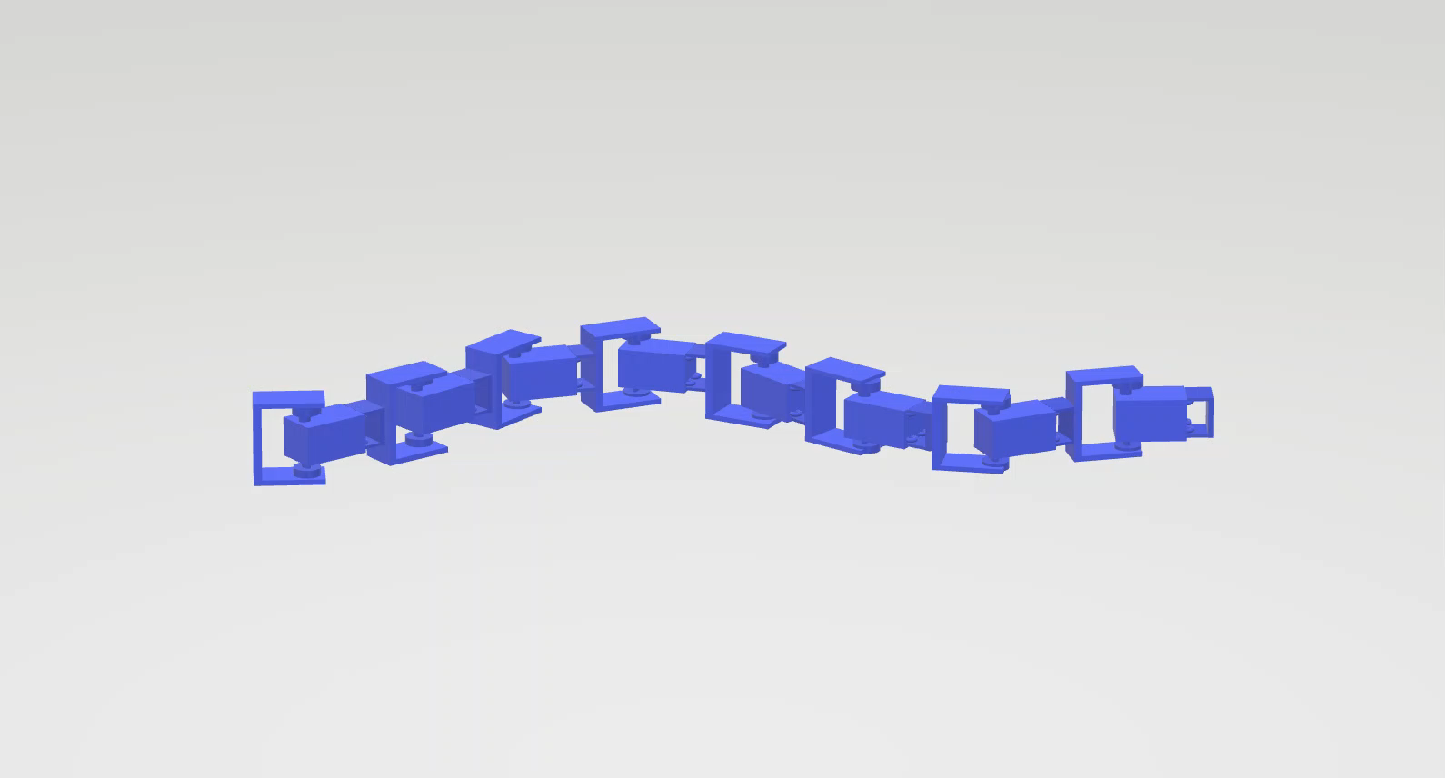
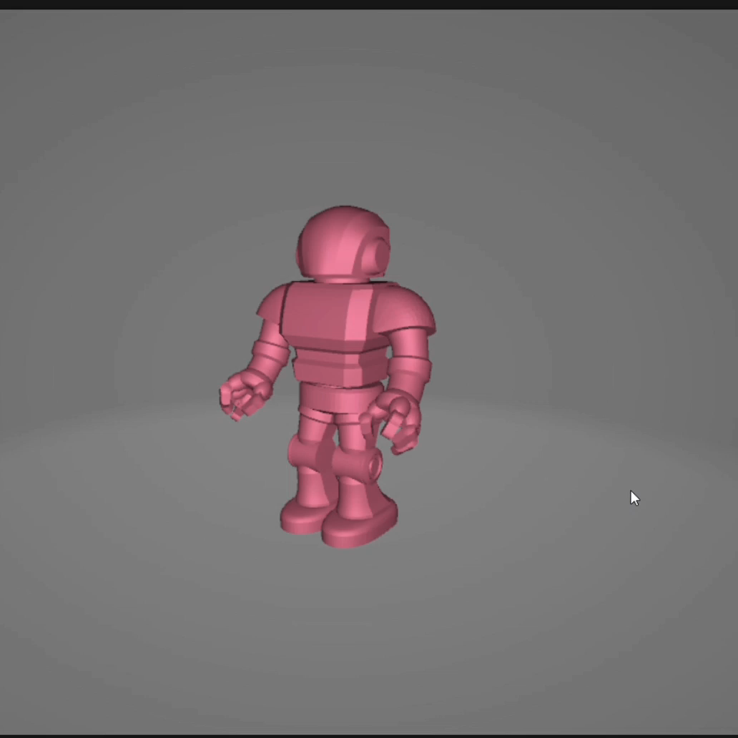
3D MODELLLING
Snake Robot
Humanoid Robot

Slide 21
EXPECTED WORKING
Start [HUMANOID ROBOT]
Getting the required inputs for the operation
Doing various tasks like walking etc.,
Live monitoring
Talking to others
Returning to the destination
Stop

Slide 22
EXPECTED WORKING
Start [SNAKE ROBOT]
Getting the required inputs for the operation
Going to the required place
Live monitoring
Search and Rescue operation
Returning to the destination
Stop

Slide 23
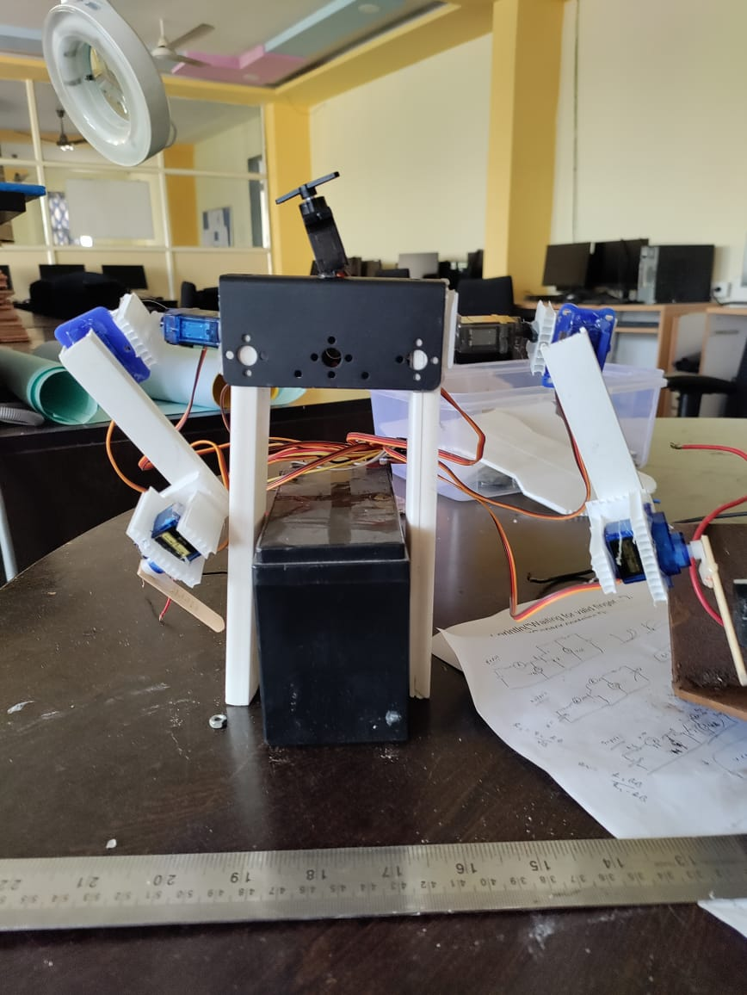
RESULTS
The demo project of the humanoid robot and it only works stationary where it can move only hands and head i.e. only upper part

Slide 24
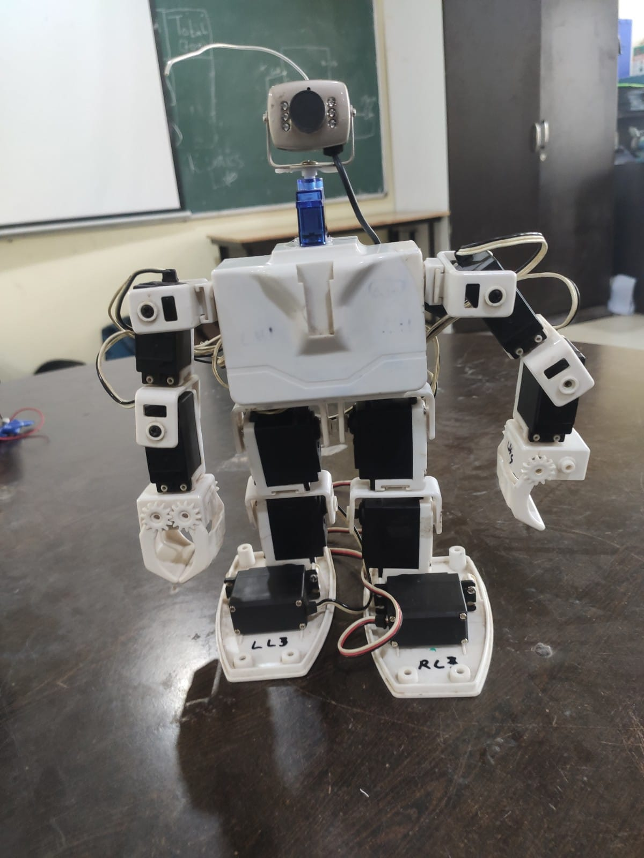
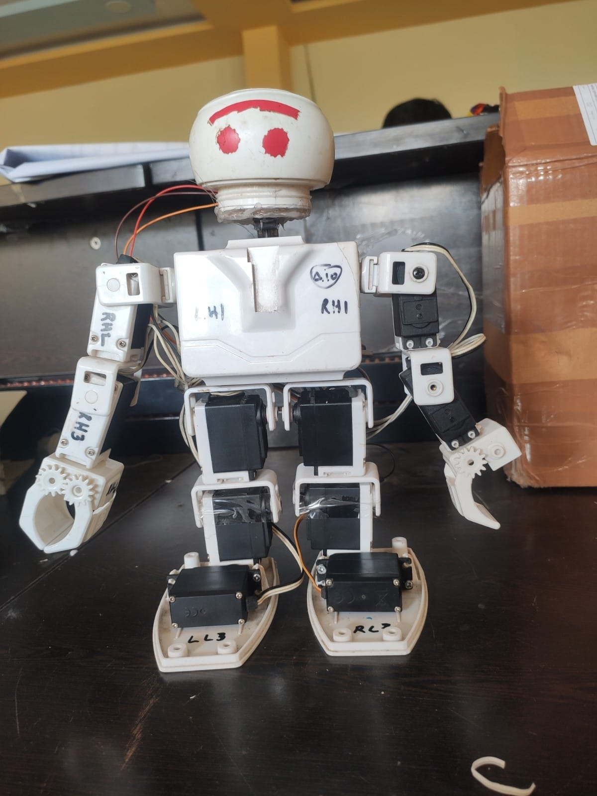
RESULTS
The final prototype of the humanoid robot performing various tasks which are specified

Slide 25
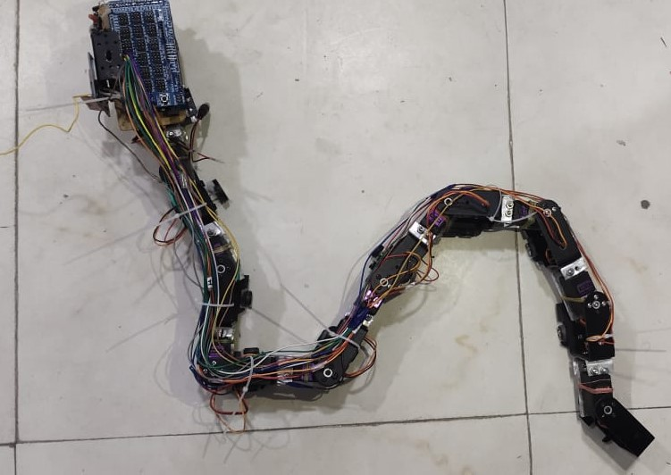
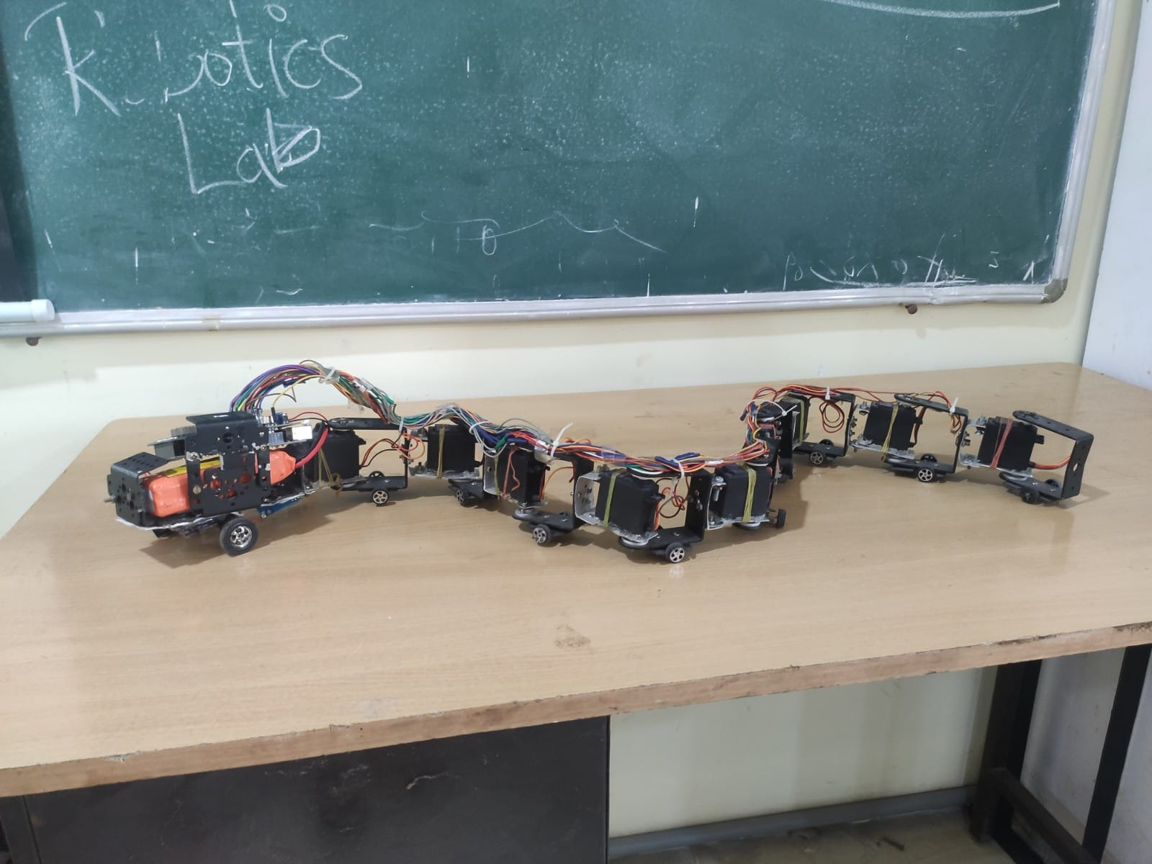
RESULTS
The final prototype of snake robot which is ready to perform various tasks or operations based on user.

Slide 26
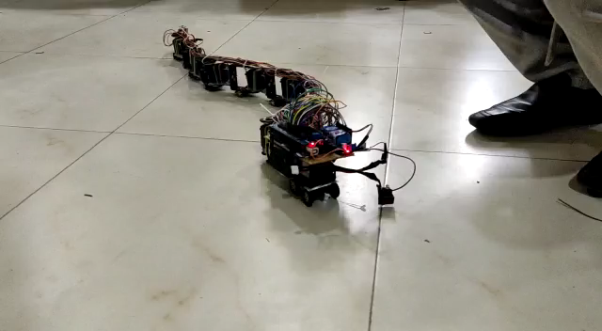
RESULTS
The proposed model runs on External power source for which we can use this model for long run by changing external power source(Battery).
Working video of snake robot

Slide 27
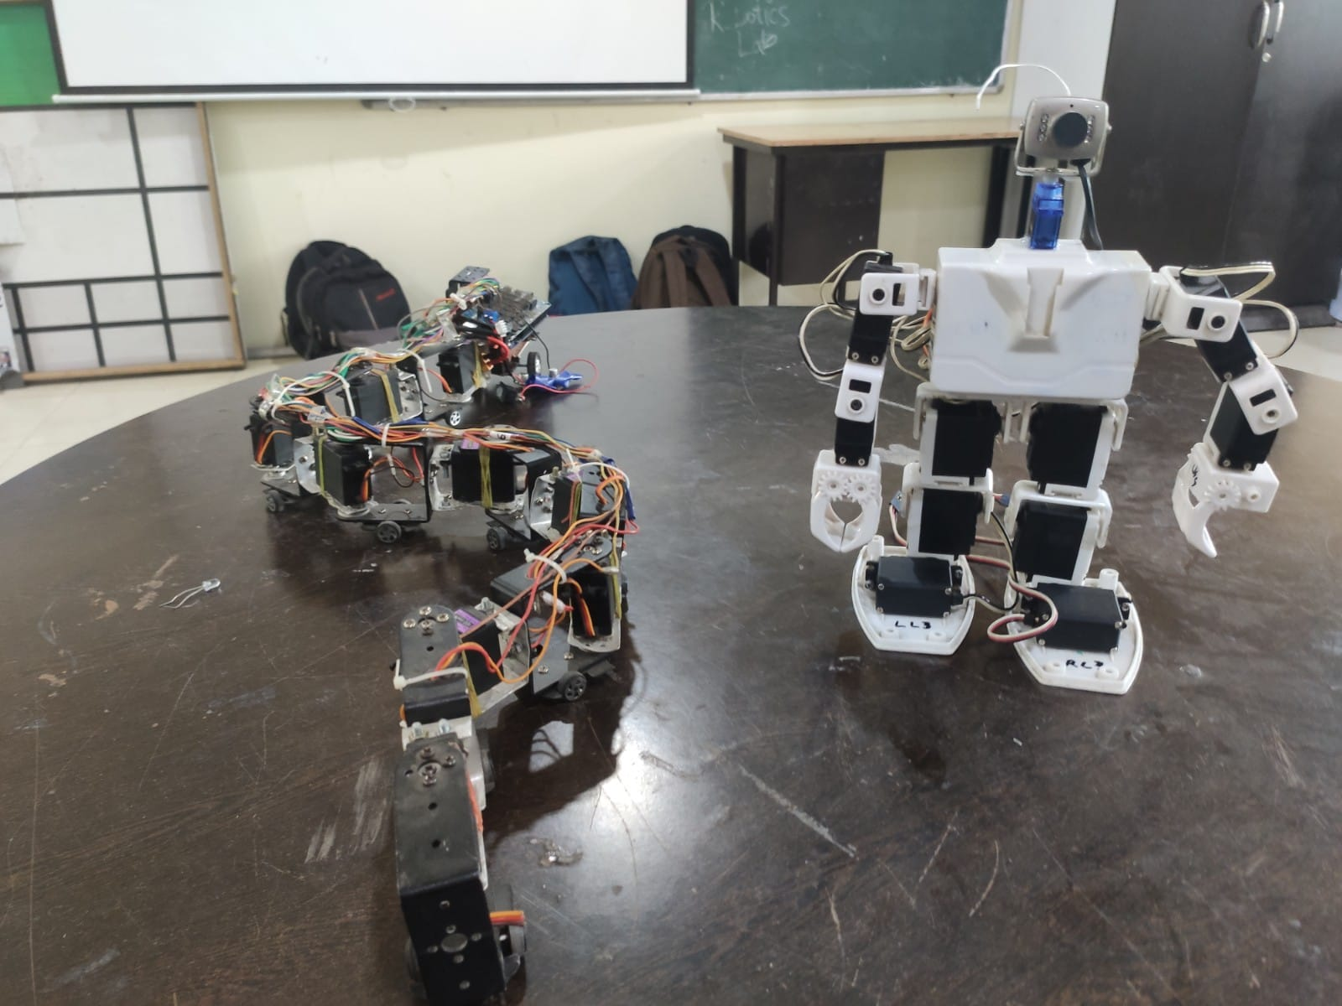
RESULTS
Final Prototypes of snake and humanoid robot

Slide 28
APPLICATIONS
Humanoid and snake robots are used in a variety of applications, including search and rescue, surveillance, and medical assistance.
They are also used for entertainment purposes, such as in movies and video games. Additionally, these robots can be used in industrial settings, such as in factories and warehouses
Snake robots can also be used for military and law enforcement operations. They can be used to detect and defuse bombs, as well as to search for and apprehend suspects.
They can also be used to explore and map unfamiliar environments, such as caves or collapsed buildings.

Slide 29
CONCLUSIONS
Snake robots are a versatile tool for a variety of applications. Their flexibility and maneuverability make them ideal for search and rescue operations, as well as for inspecting hazardous environments.
Additionally, their snake-like movements make them ideal for navigating tight spaces and performing delicate tasks.
Humanoid robots are an exciting and rapidly developing field of robotics. They are versatile and can be used in a variety of applications, from healthcare to entertainment.
As technology advances, robots will become increasingly common, as they are ideal for a variety of applications.

Slide 30
FUTURE SCOPE
By covering snake robot with polythene skin with seems to be a real time animal.
Adding extensions like bomb detectors and Automatic guns for attacking enemies.
Making robot water proof ,we can use in any weather conditions and in any medium.
Replacing Arduino with Raspberry Pi we can perform more operations.
Increasing its cost of making results better quality.

Slide 31
Cont..
THE FUTURE OF ROBOTICS
The future of robotics is an exciting one. With the implementation of snake and humanoid robots, we are entering a new era of automation and robotics.
From assisting in medical procedures to exploring unknown environments, these robots are paving the way for a new era of automation and robotics.
The implementation of snake and humanoid robots is just the beginning. As these robots become more advanced, their capabilities will only increase, opening up a world of possibilities for the future of robotics.

Slide 32
REFERENCES
N. Sawasaki, et al, “Application of Humanoid Robots to Building and Home Management Services,” Proc. IEEE Int. Conf. Robotics and Automation, pp. 2992–2997, 2003.
T. Takubo, et al., “Mobile Manipulation of Humanoid Robots - Control Method for CoM Position with External Force -,” Proc. of IEEE/RSJ Int. Conf. on Intelligent Robots and Systems, pp.1180–1185,2004.
H. Ono, T. Sato, and K. Ohnishi, "Balance recovery of ankle strategy: Using knee joint for biped robot," Proc. of International Symposium on Access Spaces, Yokohama, Japan, pp. 236-241, 2011.

Slide 33
Cont..
P. Liljebäck, K. Y. Pettersen, Ø. Stavdahl, and J. T. Gravdahl, “A review on modelling, implementation, and control of snake robots,” Robotics and Autonomous Systems, 2012, vol.60, no.1, pp. 29-40.
M. Saito, M. Fukaya, and T. Iwasaki, “Serpentine locomotion with robotic snakes,” IEEE Control Systems Magazine, 2002, vol.22, no.1,pp. 64–81.
H. Date, Y. Hoshi and M. Sampei, “Dynamic Manipulability of a Snake-Like Robot,” Proceeding of the 39th IEEE Conference on Decision and Control, December 2000.

Slide 34
THANK YOU

